Slide 1

NYC Vehicle Collision Analysis
This project aims to uncover key insights from collision data to improve safety and efficiency on our city's streets.

Slide 2
Project Overview
Objective
Scope
Impact
To develop an advanced forecasting model that accurately forecasts future crash occurrences or weather conditions, enhancing safety planning, risk mitigation, and resource allocation. The goal is to provide actionable insights for improving public safety and optimizing response strategies in real-time.
We analyze a dataset of historical collision data & weather data using a Random Forest model to uncover underlying patterns, trends, and correlations, providing valuable insights for predictions and safety improvements.
This analysis will provide insights to guide strategies for enhancing road safety and optimizing traffic flow.

Slide 3
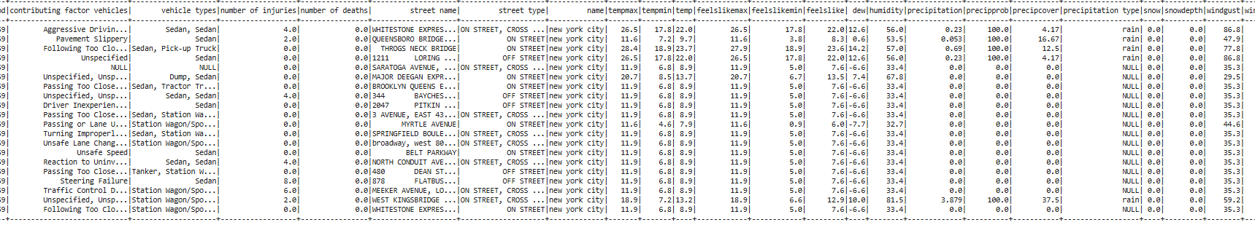
Prediction, Inference, and Goals
1
Predict Collision probability
2
Infer Contributing Factors
Using big data elements like historical collision records, and environmental factors, collision probabilities can be accurately predicted in NYC. Machine learning algorithms analyze these datasets to identify patterns and provide forecasting insights for traffic safety improvements.
By examining weather patterns and temporal trends, crucial factors that contribute to vehicle collisions can be determined.
Machine learning algorithms assist in identifying correlations and key variables that affect accident rates, supporting the development of focused safety interventions.
3
Analyze Temporal Trends
By examining temporal trends in collision data, such as accident frequency over different times of day, days of the week, and seasons, patterns in collision rates can be identified. Big data analytics and time-series models help uncover peak accident periods, guiding preventative strategies and resource allocation.

Slide 4
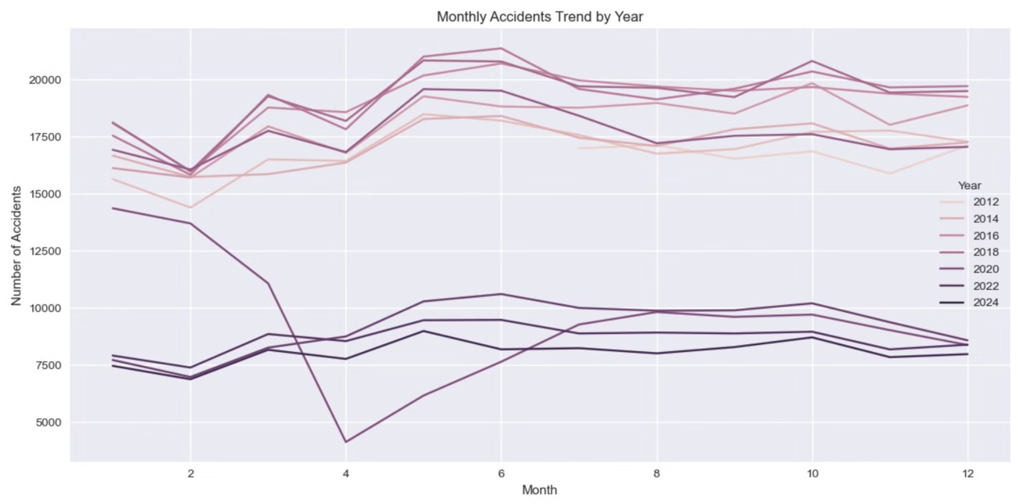
Data Exploration and Visualizations
The number of accidents shows a consistent decline over the years.
Seasonal peaks, especially mid-year, were more prominent in earlier years compared to recent years.
The number of accidents shows a consistent decline over the years.
Seasonal peaks, especially mid-year, were more prominent in earlier years compared to recent years.

Slide 5
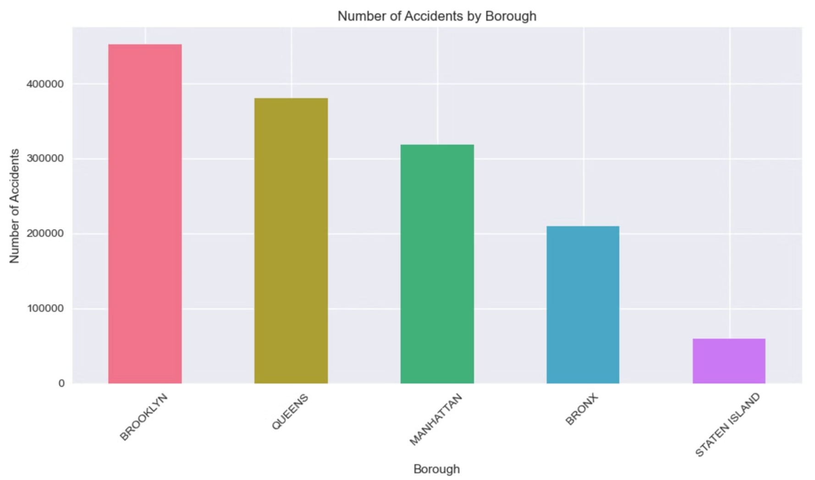
Brooklyn leads with the highest number of accidents, followed by Queens and Manhattan. The Bronx has fewer accidents compared to these boroughs, while Staten Island records the least number of accidents among the five boroughs.
Brooklyn leads with the highest number of accidents, followed by Queens and Manhattan. The Bronx has fewer accidents compared to these boroughs, while Staten Island records the least number of accidents among the five boroughs.

Slide 6
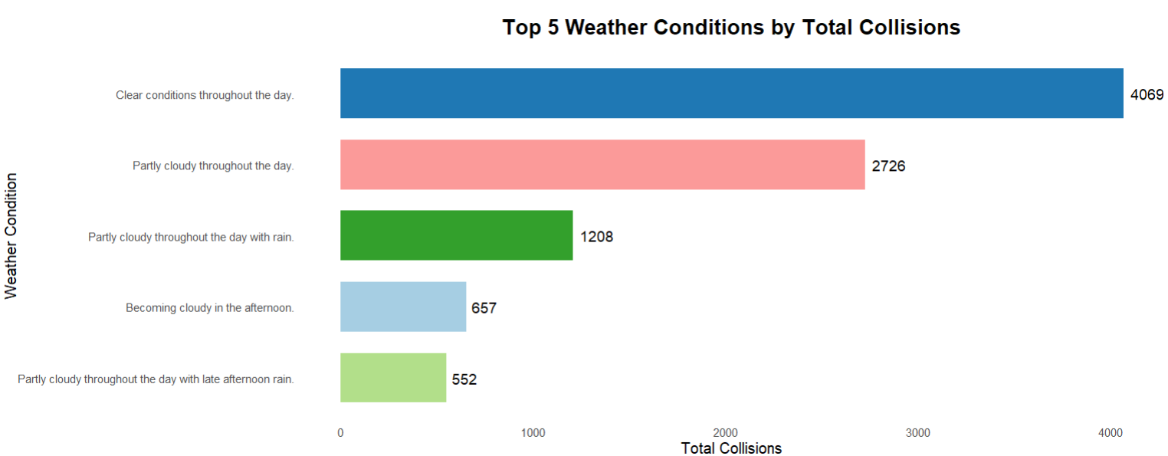
Interesting and Surprising Results
More Collisions on Clear Days: While we generally expect more accidents during adverse weather conditions (snow, rain, fog), our analysis revealed that a higher number of collisions occurred on clear, dry days.

Slide 7
Challenges Faced
Data Limitations:
Handling Missing and Imbalanced Data: Addressed incomplete or missing values and managed uneven class distributions to ensure unbiased analysis and improved model performance.
1
Improving Data Quality and Scalability: Corrected inaccurate data entries and implemented efficient processing techniques to manage large datasets, ensuring reliable and scalable model performance.
Model Refinement
Model Ensemble: Compared multiple models, such as Random Forest and Linear Regression, to leverage their strengths and improve overall performance and robustness.
2
Impact Assessment
Scalability and Efficiency: Assessed the model's capability to process large datasets and deliver insights efficiently in a big data environment.
3

Slide 8
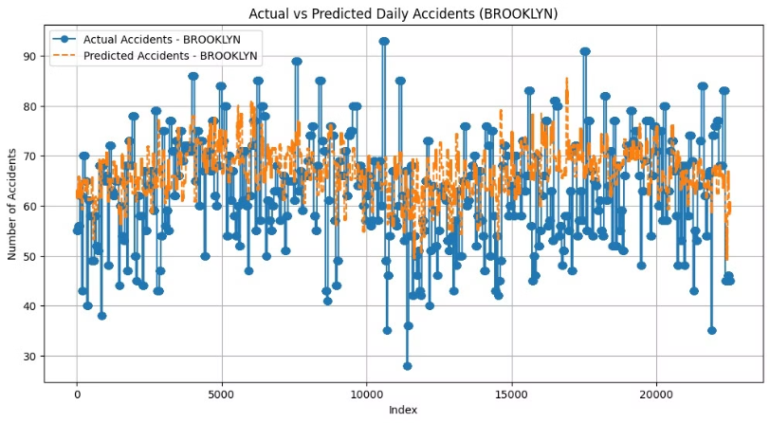
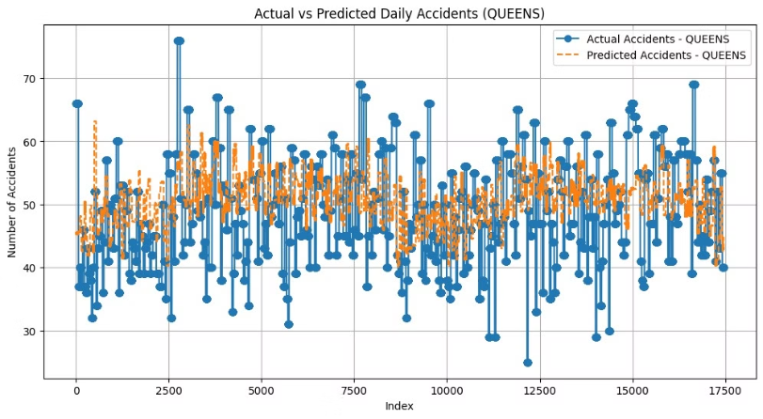
Result Summary

Slide 9
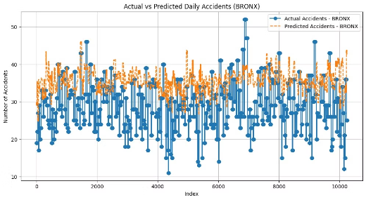
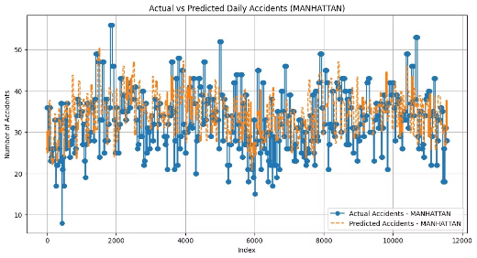
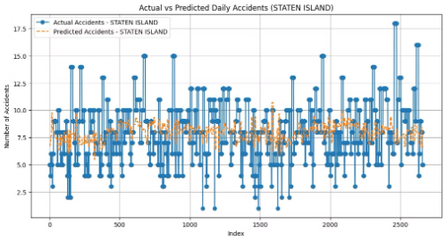
Model Accuracy Across Boroughs: The forecasting model demonstrates strong alignment between actual and predicted daily accident counts across all boroughs, with notable consistency in Staten Island due to its lower accident variability. However, higher accident boroughs like Brooklyn and Manhattan show increased variability in predictions.
Performance Insights: The model effectively captures overall trends, but slight underestimations or overestimations occur at extreme values, particularly in boroughs with wider accident ranges, suggesting room for refinement in addressing outliers or higher variability regions.

Slide 10
Borough-wise RMSE value
Borough: QUEENS
Mean Absolute Error (MAE): 6.833
Root Mean Squared Error (RMSE): 8.639
Borough: BROOKLYN
Mean Absolute Error (MAE): 8.670
Root Mean Squared Error (RMSE): 10.768
Borough: BRONX Mean
Absolute Error (MAE): 7.301
Root Mean Squared Error (RMSE): 8.784
Borough: MANHATTAN
Mean Absolute Error (MAE): 5.813
Root Mean Squared Error (RMSE): 7.221
Borough: STATEN ISLAND
Mean Absolute Error (MAE):2.235
Root Mean Squared Error (RMSE):2.878

